Slide 1


Predicting the future of the S&P 500 Index
*Due to technical issues, you will have to go through the slides manually and play my recording
Ori Rinaman
Bellevue University
Notes:
Better introduction with class number and university

Slide 2

Background
The United States has the biggest stock market in the world
Investing in the stock market is a major part of many peoples lives (stocks, 401k’s, etc.)
There are three major indexes that track the performance of various aspects of the market
DOW Jones Industrial Average
NASDAQ
S&P500
The S&P500 index is solely based on the 500 largest companies in the United States
Understanding any future aspects of the market can be an advantage to investors

Slide 3
Problem Statement
For decades people have been trying to beat the market trying to time it just right to make a fortune. For my term project my goal was to determine if an accurate model can be created to predict the performance of the S&P500 index. The outcome the models will be predicting is if the index will either rise or fall next month. Having the advantage of knowing how the index will perform is a huge advantage when it comes to investing. An accurate model could prove to be highly valuable. The data I will be using to develop the model will be from many of the lead indicators economists use to try and understand the market.

Slide 4
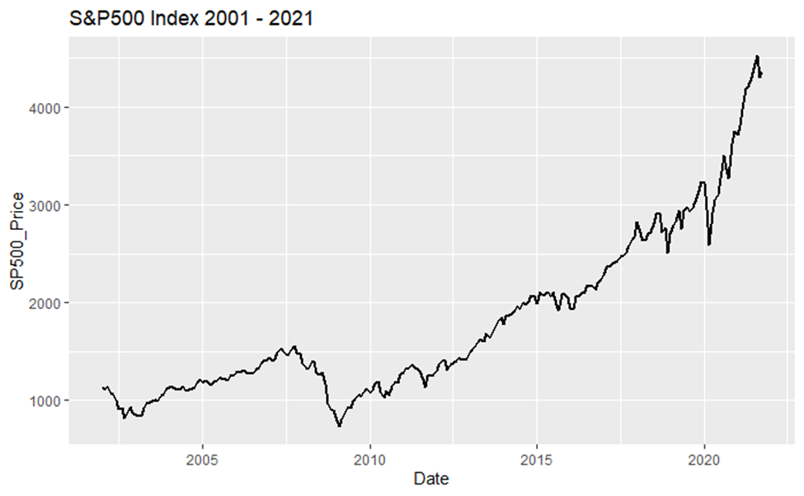
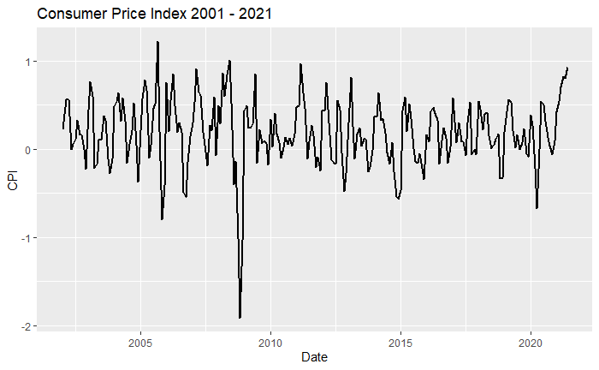
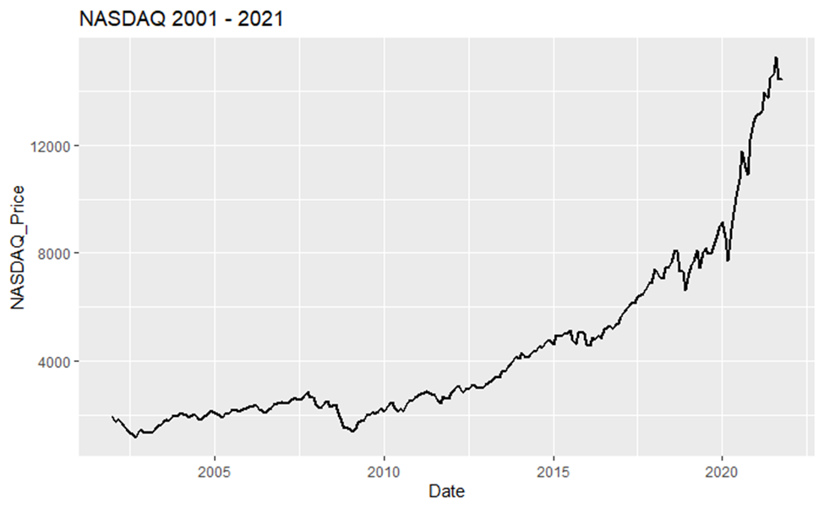
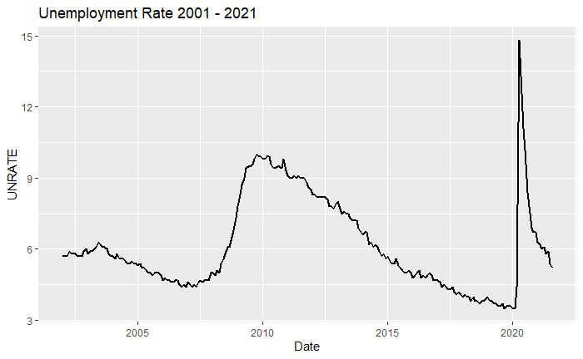
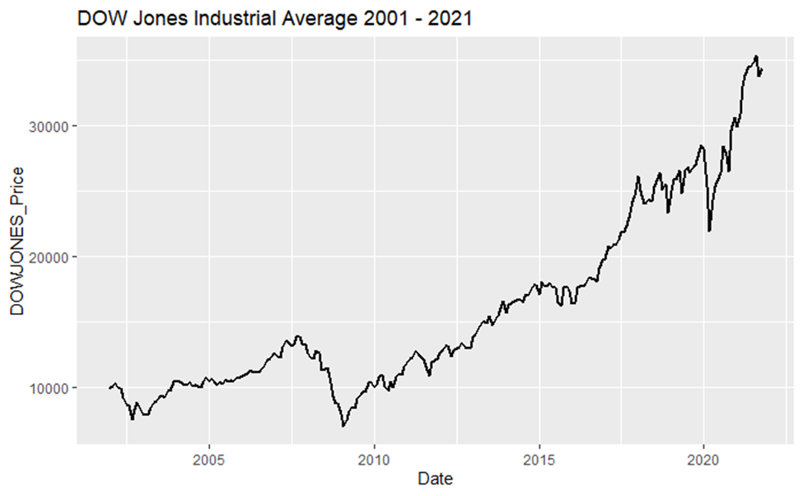
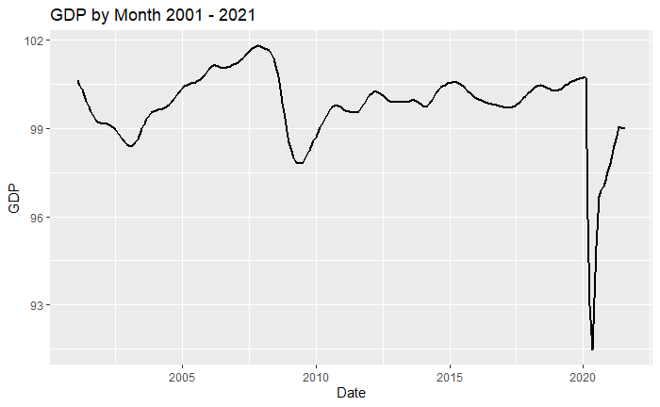
Data
S&P500 Monthly 2001 – 2021
NASDAQ Monthly 2001 – 2021
DOW Monthly 2001 – 2021
Consumer Price Index (CPI) 2001 – 2021
Unemployment Rate 2001 – 2021
Gross Domestic Product (GDP) 2001 – 2021
Aggregated to our target variable called “Status”
0 = rise
1 = fall
Changed to percent change from previous month

Slide 5
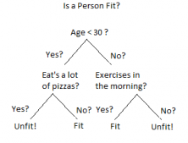
Methods (Decision Trees)
Supervised Machine Learning for both Classification and Regression
Visual representation of decisions and decision making
Data is continuously split according to a certain parameter

Slide 6
Methods (Random Forrest)
Supervised Machine Learning technique that is constructed from decision tree algorithms
Random Forrest models are used for classification and regression problems
Constructed from many decision trees hence the “Forrest”
Outcome is established based on the predictions of the decision trees by taking the average mean output from various trees
Proven to reduce overfitting and increase precision

Slide 7
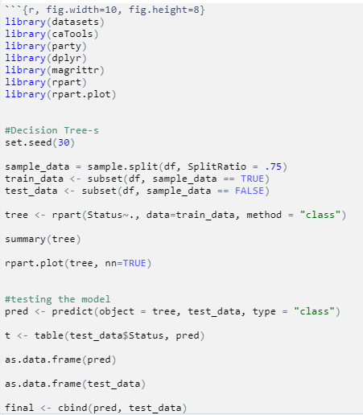
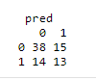
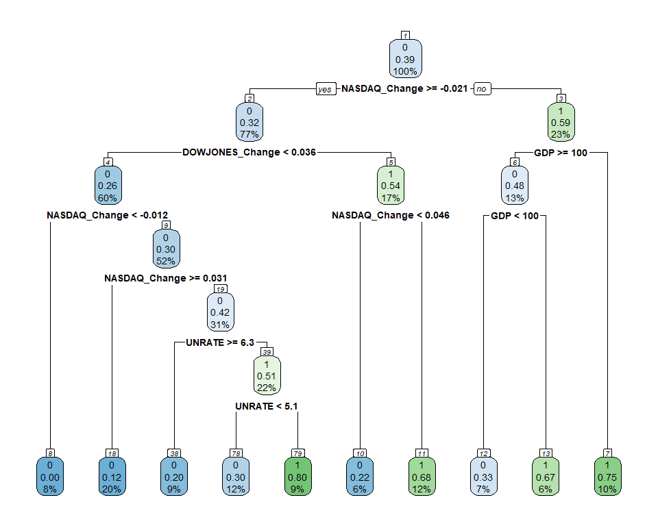
Decision Tree Results
Training Data – 75% (161 observations)
Testing Data – 25% (80 observations)
64% Accuracy vs. Testing Data

Slide 8
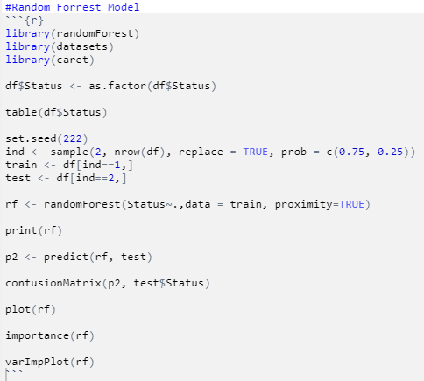
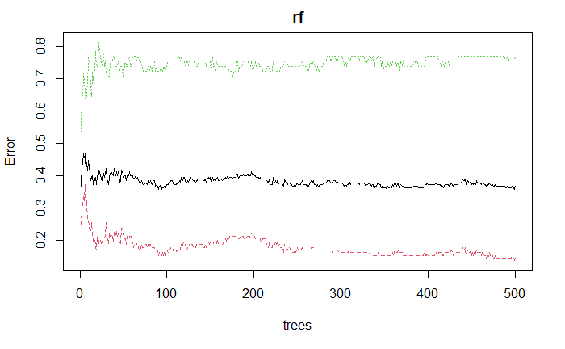
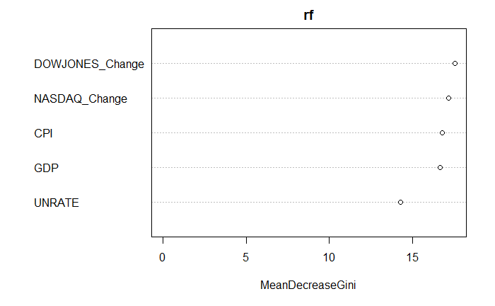
Results Random Forrest
Training Data – 75% (161 observations)
Testing Data – 25% (80 observations)
61% accuracy vs. Testing Data
Variable Importance

Slide 9
Issues/Challenges
Trying to find large amount of data that go back multiple decades
Getting Date Time formats to match in R with multiple data sets from different sources
Other outside, unpredictable factors that affect the stock market/index

Slide 10
Future Steps
Spend more time investigating more factors that can influence the stock market / S&P500 index
Adding more variables
Adding data from before 2001
Learning more about time series analysis and how I could have applied to this project

Slide 11
Conclusion

